Slide 1
Intelligent Tourist Recommendation system
Presented By:
Akrish Pun Magar
Alisha Byanjankar
Pankaj Bhattarai
Pramod Khatiwada

Slide 2
Contents:
Introduction
Problem Definition
Objectives
Requirement Analysis
Feasibility Analysis
System Design And Flow Diagrams
Implementation and Testing
Conclusion And Recommendations

Slide 3
Introduction:
A web based tourism service.
It provides the recommendation to the user or visitors according to their query.
The user have to fill up the form according to their choices and they will be recommended with the appropriate destinations.

Slide 4
Problem Definition:
Traveler has to search through different sites to get the appropriate results.
Time consuming as the searching is very hectic process.

Slide 5
Objectives:
The primary objective of this project is to serve people through web-based tourism service.
To remove the uncertainty of the travelers about the trip.
To help those who are not familiar with the travelling.
To make the current tourism system smart with the implementation of AI.

Slide 6
Requirement Analysis:
Functional Requirements:
Describes what system should do when the input is obtained.
Information about the different places.
Users requirements.
Recommendations

Slide 7
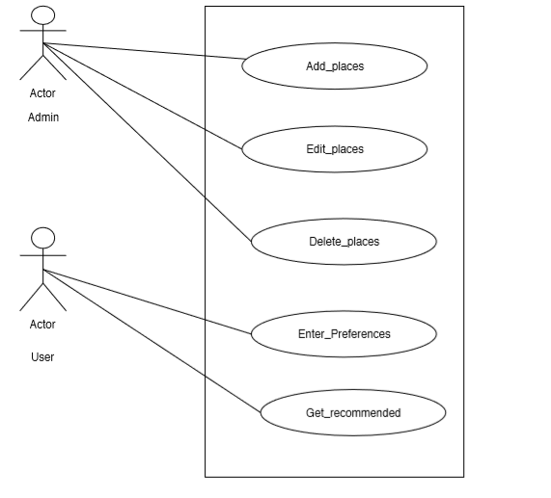
Use case diagram:

Slide 8
Non-Functional Requirements:
Describes how the system performs the certain function.
Specify the system’s quality attributes or characteristics.
Some of non-functional requirements includes:
The use of cosine similarity function.
The system should be capable of using large number of visitors.
The users should follow the input pattern to search the destinations.

Slide 9
Feasibility Analysis:
To confirm the current system is feasible or not according to different factors such as;
Economic Feasibility:
The system is economically feasible.
Operational Feasibility:
It is feasible into real world implemented system.
Technical Feasibility:
It is technically feasible.

Slide 10
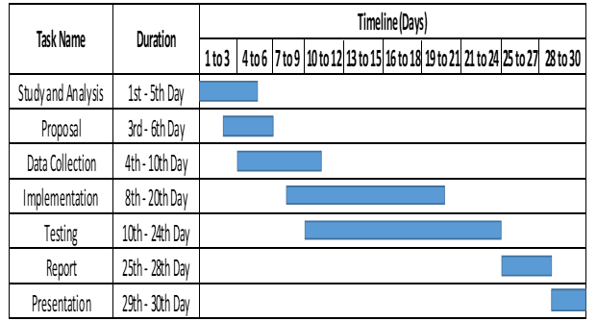
Schedule Feasibility:
Following Gantt chart shows the proposed schedule to perform the project:

Slide 11
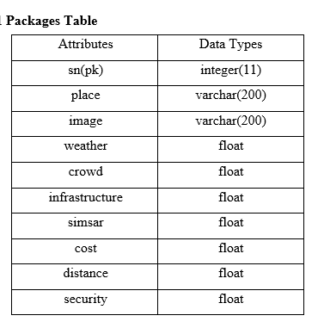
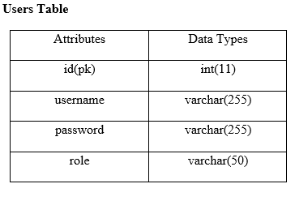
System Design And Flow Diagrams:
System Design
Database Schema Design:
There are two tables i.e. Packages table to store values of places and users table to store the result of users.

Slide 12
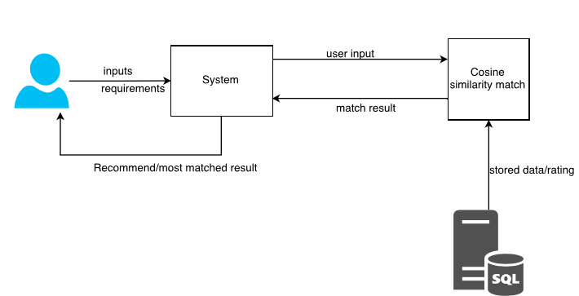
Block Diagram:
A block diagram is a diagram showing in schematic form the general arrangement of the parts or components of a system or process.

Slide 13
Implementation And Testing:
Implementation Tools:
HTML, CSS, BOOTSTRAP
PHP and Sublime Text
MySQL and XAMPP Server
Edraw Max

Slide 14
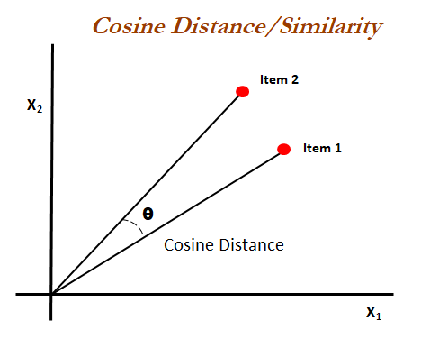
Algorithm Implementation:
Cosine Similarity:
Cosine similarity method measures the similarity between two objects based on an angle formed by two objects in vector space. The cosine similarity ranges between 0 and 1 if the values in vectors are positive. A cosine similarity of 1 represents complete similarity between two objects and that of 0 represents complete dissimilarity. The user input contains weather, crowd, infrastructure, water resources, cost, distance and security.
The formula for calculation is:
Cos (a, b) = (a.b)/ (||a||×||b||)
where,
||a|| and ||b|| are the Euclidean norms of vectors a and b, respectively, and a. b is dot product between vectors a and b.

Slide 15
Testing:
Unit Testing
Integration Testing
System Testing

Slide 16
Conclusion And Recommendations:
Conclusion:
Hence, we have developed web-based application named as “Intelligent Tourist Recommendation System”.
Our project facilitates people to search for a destination to visit. Based on the user’s input parameter the system recommends the destinations to user.
Recommendations:
This project can be enlarged and make more accurate if more research is done and more effective functions are added.
For this, more effective recommendation algorithms should be used.
Furthermore, ranking system of the results based on their services using Machine learning algorithms, discussion forums etc. could be added in the system.

Slide 17
ANY QUERIES?? Thank You!!

